Slide 1



Crowdfunding
Fall 2025 capstone project | Prof Henry Wong
By
Team Nexus

Slide 2
Agenda
Team Member Roles | Improvements | Responsibilities
Problem Statement | Project Description | Team Working Agreement
User Personas | MVP | Project Design
Technologies | Algorithms | Diagrams
Product Backlog
Sprint Summary
Metrics
Sprint 2 Recap
Sprint 3
User Stories
Test Cases
Stories Completed
Stories Not Completed
Metrics
Retrospective
Project Demo

Slide 3





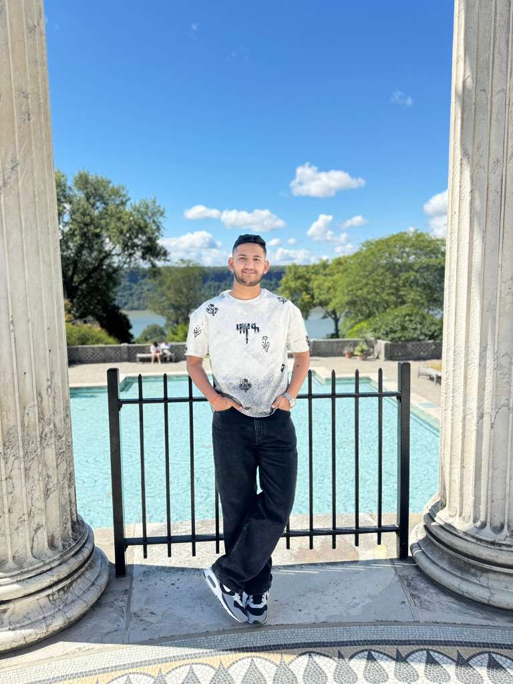
Getting to know the Team…
Ashwanth Maram Full Stack Developer
Ashwitha Maram
Developer/Tester
Raj Mandaliya
Block Chain Developer

Slide 4






Getting to know the Team…
Vinukonda Yashwanth Reddy Backend and Database Engineer
Nyi Nyi Lwin Full Stack Developer
Naveen Pesalabanda
SCRUM Master

Slide 5

Improvements
Improved Algorithms section
Improved sprint backlog and product backlog
Improved test cases
Improved the Metrics (Team Velocity, Sprint Burn down Chart, Completed Committed Ratio)
Improved project demo section

Slide 6
Project Description

Slide 7
Team Working Agreement
Communication Expectations
Use Zoom, GitHub for collaboration.
Respect everyone opinions; decisions are made collectively.
Notifying the team in advance if you cannot complete or attend.
In case of any conflicts, present research-backed solutions and resolve by majority vote.
Keeping everyone updated when pushing code or making changes.
No last-minute dumping of work on others.
Meeting Schedules
Meetings will be held twice weekly on Zoom or Google meet
Meeting time is set based on availability.
Agenda will be shared in advance for preparation.
Sprint Planning at the start, Retrospective at the end of each sprint.
Absence must be informed ahead of time; member must read meeting summary.
All members are expected to participate and contribute fairly.

Slide 8
Team Working Agreement
Checklist for Task Completion
Code should run without errors.
Work must meet all acceptance criteria.
Each task is reviewed and tested by everyone
Documentation should be updated with the task.
Final review by all team members before submission.
Team Dynamics & Principles
Each member must clearly understand and own their tasks.
Workload distributed fairly; large tasks broken into smaller ones.
Every task has a deadline and review on completion.
Encourage problem-solving before escalating blockers.
Trackers must be updated regularly.
Work progress should be committed and shared on GitHub.

Slide 9

The Startup Founder Persona
Name: Alice Johnson Age: 28 Gender: Female Occupation: Startup Founder
Alice is an ambitious entrepreneur developing a sustainable fashion brand. She wants to raise money to bring her eco-friendly products to market but struggles with high fees and limited visibility on traditional crowdfunding platforms.
Challenges:
Struggles to gain trust from contributors due to lack of transparency.
Centralized platforms charge high fees, cutting into her funding.
Limited control over how her campaign is presented.
Goals:
Raise funds fairly and transparently.
Build credibility with backers.
Ensure contributors see exactly how their money is being used.

Slide 10

The Investor Persona
Name: Bob Smith Age: 35 Gender: Male Occupation: Investor
Bob is a passionate investor who likes to fund innovative projects. He wants to support creators but often worries about whether his money is being used properly and feels disconnected after contributing.
Challenges:
Unsure if funds are spent transparently
No refunds if a project fails
Has no control once money is invested
Goals:
Invest with full transparency and security
Receive refunds if funding goals aren’t met
Have a say in how project funds are used through voting

Slide 11

The Community Member Persona
Name: Cathy Lee Age: 22 Gender: Female Occupation: College Student / Community Member
Cathy is an active member of online communities and DAOs. She enjoys contributing to causes but wants her voice to count, not just her money.
Challenges:
No say in how project funds are allocated
Hesitant to contribute without accountability
Finds most platforms profit-driven and restrictive
Goals:
Participate in voting and decision-making
Support transparent, community-driven projects
Learn about blockchain while backing meaningful causes

Slide 12

MVP
Campaign Creation: Allow users to launch funding campaigns with metadata (title, goal, deadline).
Contribution Logic: Accept ETH contributions and track them per user.
Refund Mechanism: Automatically refund contributors if the goal isn’t met.
Governance Voting: Let contributors vote on fund allocation or milestones.

Slide 13

TOOLS &Technologies
Blockchain: Ethereum + Solidity
Development: Remix IDE, Hardhat
Network: MetaMask, Sepolia Test Network, Sepolia ETH Faucets
Deployment & Testing: Hardhat
Collaboration Tools: GitHub, VS Code

Slide 14

Algorithms & Logic
Contribution Algorithm
Algorithm Steps
Ensure the current time is before the deadline.
Check that the contribution meets the minimum amount.
Register new contributors.
Update contributor balance and total raised amount.
function sendEth() public payable {
require(block.timestamp < deadline);
require(msg.value >= minContribution);
if (contributors[msg.sender] == 0) {
totcontributors++;
}
contributors[msg.sender] += msg.value;
raisedAmount += msg.value;
}

Slide 15

Algorithms & Logic
Refund Algorithm
Algorithm Steps
Check that the deadline has passed.
Ensure the target was not reached.
Verify caller is a contributor.
Return contributed Ether.
function refund() public {
require(block.timestamp > deadline);
require(raisedAmount < target);
require(contributors[msg.sender] > 0);
uint amount = contributors[msg.sender];
contributors[msg.sender] = 0;
payable(msg.sender).transfer(amount);
}

Slide 16

Algorithms & Logic
Request Approval & Payment Algorithm
Algorithm Steps
Manager creates a spending request.
Contributors vote (one vote per contributor).
After deadline, check majority approval.
Transfer funds and mark request completed.
function makePay(uint256 _requestNo) public {
Request storage r = request[_requestNo];
require(block.timestamp > deadline);
require(raisedAmount >= target);
require(!r.completed);
require(r.totVoters > totcontributors / 2);
r.recipient.transfer(r.value);
r.completed = true;
}

Slide 17
Diagrams

Slide 18
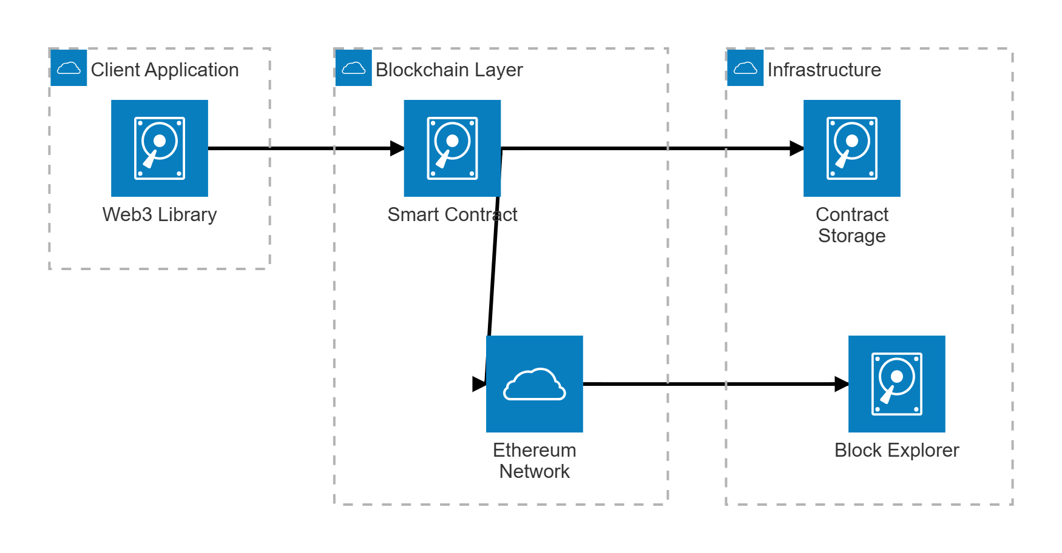
Architecture Diagram

Slide 19
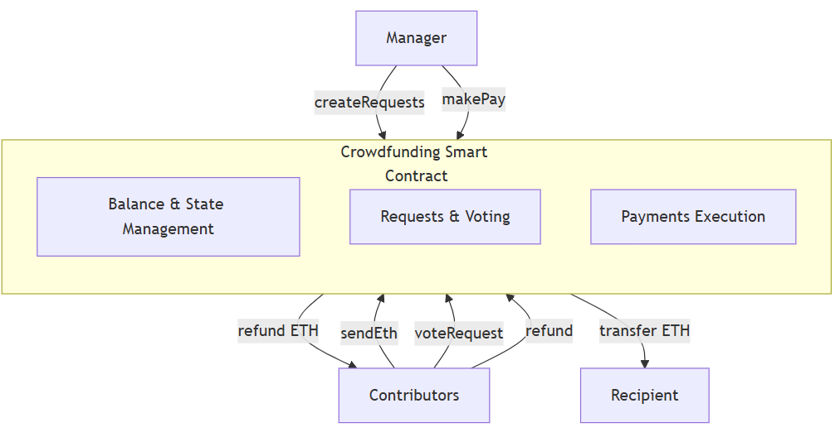
Context Diagram

Slide 20
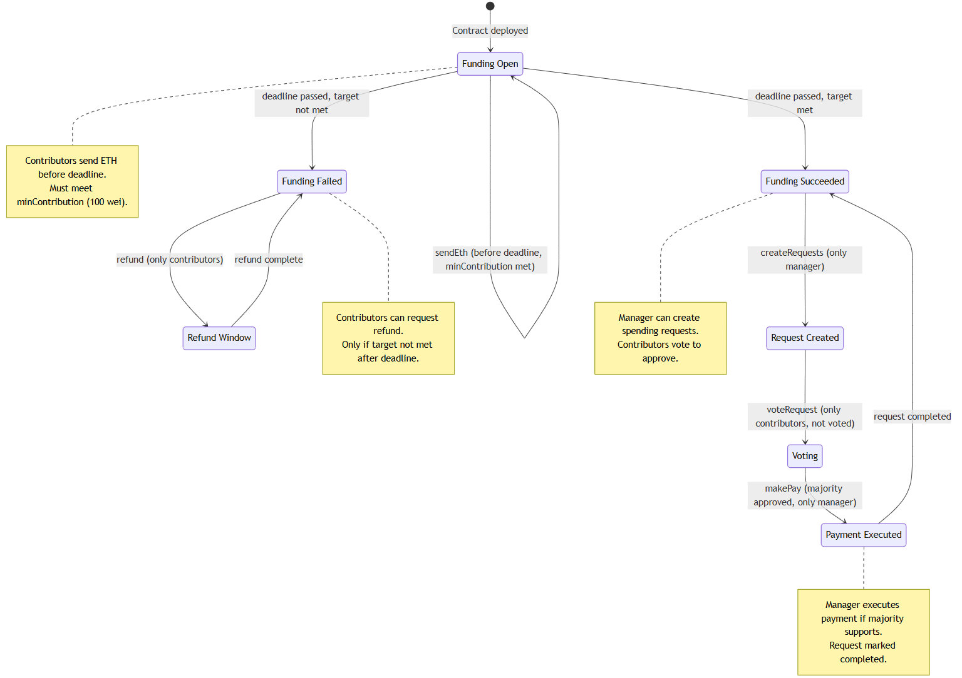
state Diagram

Slide 21
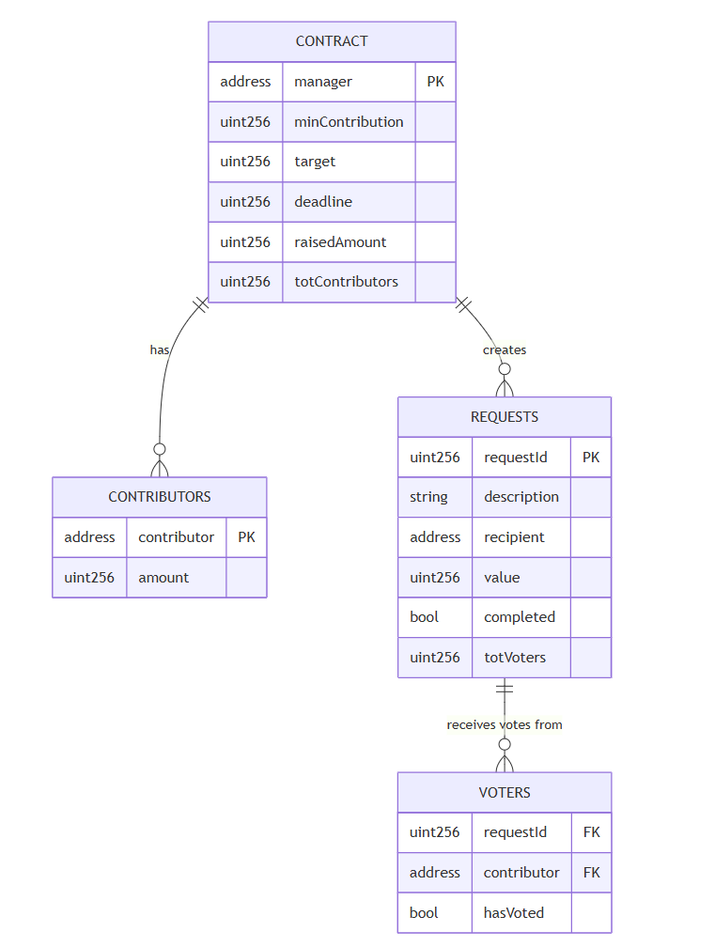
ER Diagram

Slide 22
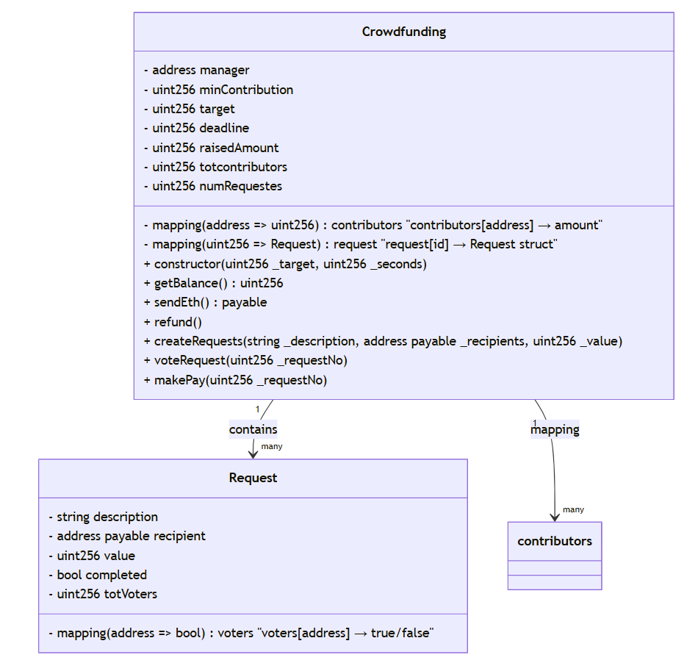
Class Diagram

Slide 23
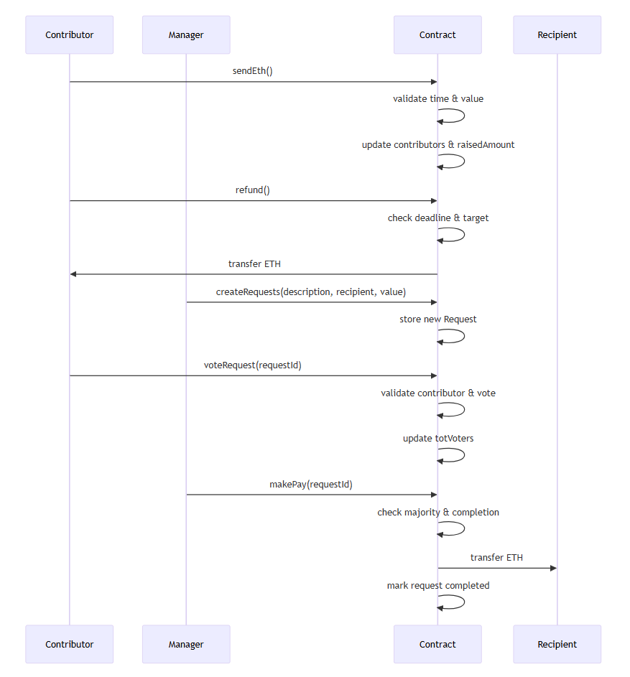
Sequence Diagram

Slide 24
Sprint 2 Recap (21 pts)
Goal: Implement fund management features in the crowdfunding system.
User Stories Completed:
US_04 – Create Spending Requests (Manager) Manager can propose how raised funds are used by creating requests with description, recipient, and amount.
US_05 – Vote on Spending Requests (Contributor) Contributors can vote on requests (one vote per contributor) to influence fund usage.
US_06 – Release Funds After Approval (Manager) Funds can be released only if a request has majority approval, ensuring responsible fulfillment.
Outcome: Voting-based governance implemented; contributors control spending; managers can propose requests securely.

Slide 25
Product Backlog

Slide 26
No. | User Story | Acceptance Criteria | Feature Name | Component | Story Points
US_01 | As a campaign manager, I want to create a new campaign with a target and deadline so that I can raise funds. | Given I am the manager, When I deploy the contract with a target and deadline, Then the campaign is initialized and I am set as owner. | Campaign Creation | Smart Contract | 8
US_02 | As a contributor, I want to contribute funds to a campaign so that I can support causes I believe in. | Given the campaign is active, When I send ETH above the minimum, Then my contribution is recorded and the total raised updates. | Campaign Contribution | Smart Contract | 5
US_03 | As a contributor, I want to get a refund if the campaign fails so that I don’t lose my funds. | Given the deadline has passed and the target was not met, When I request a refund, Then I receive my ETH and my record is cleared. | Refund Processing | Smart Contract | 5
US_04 | As a manager, I want to create spending requests so that I can propose how to use the raised funds. | Given I am the manager, When I create a request with description, amount, and recipient, Then the request is stored with a unique ID. | Request Creation | Governance | 8
US_05 | As a contributor, I want to vote on spending requests so that I can influence how funds are used. | Given I am a contributor, When I vote on a request I haven’t voted on before, Then my vote is recorded and vote count increases. | Request Voting | Governance | 5

Slide 27
No. | User Story | Acceptance Criteria | Feature Name | Component | Story Points
US_06 | As a manager, I want to release funds after majority approval so that requests can be fulfilled responsibly. | Given the deadline has passed and the target is met, When a request has majority support and I execute it, Then ETH is transferred and request marked completed. | Fund Release | Governance | 8
US_07 | As a user, I want to view all campaigns with details so that I can choose which to support. | Given campaigns exist, When I open the campaign list, Then I see each campaign’s goal, raised amount, and current status. | Campaign Listing | Data Display | 5
US_08 | As a user, I want to see campaign status so that I know whether it’s active, successful, or failed. | Given a campaign has a deadline and target, When time passes or funds are raised, Then the status updates to Active, Successful, or Failed. | Campaign Status | Data Display | 3
US_09 | As a system, I want to validate minimum contributions so that campaigns remain fair and secure. | Given a contribution is below the minimum, When a user tries to send ETH, Then the transaction is rejected and an error message is shown. | Validation Logic | Contract Validation | 2

Slide 28
Product Backlog overview
Sprint 1 (15 pts) | Sprint 2 (21 pts) | Sprint 3 (13 pts)
US_01: As a campaign manager, I want to create a new campaign with a target and deadline so that I can raise funds. | US_04: As a manager, I want to create spending requests so that I can propose how to use the raised funds. | US_03: As a contributor, I want to get a refund if the campaign fails so that I don’t lose my funds
US_02: As a contributor, I want to contribute funds to a campaign so that I can support causes I believe in | US_05: As a contributor, I want to vote on spending requests so that I can influence how funds are used. | US_07: As a user, I want to view all campaigns with details so that I can choose which to support.
US_09: As a system, I want to validate minimum contributions so that campaigns remain fair and secure. | US_06: As a manager, I want to release funds after majority approval so that requests can be fulfilled responsibly. | US_08: As a user, I want to see campaign status so that I know whether it’s active, successful, or failed.

Slide 29
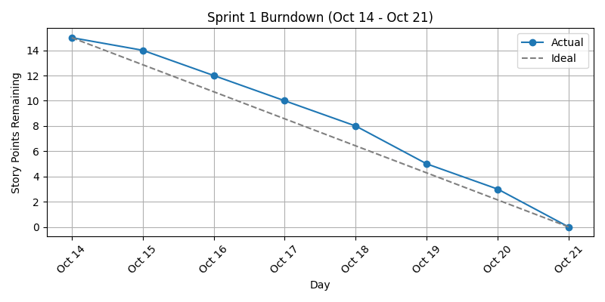
SPRINT SUMMARY
Sprint 1 Summary (Oct 14 – Oct 21)
Sprint Goal: Enable basic campaign creation and contribution functionality while enforcing fair contribution rules.
Completed User Stories (15 pts):
US_01: Campaign creation with target and deadline (Completed)
US_02: Contribution to campaigns (Completed)
US_09: Validation of minimum contributions (Completed)
Sprint Outcome: All planned user stories were completed. The campaign manager can now create campaigns with specific targets and deadlines. Contributors can fund campaigns while the system ensures minimum contribution rules are enforced.

Slide 30
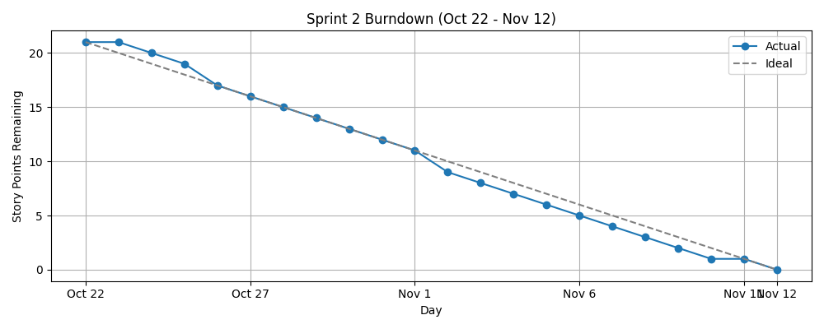
SPRINT SUMMARY
Sprint 2 Summary (Oct 22 – Nov 12)
Sprint Goal: Implement spending management, including requests, contributor voting, and fund release after approval.
Completed User Stories (21 pts):
US_04: Manager can create spending requests (Completed)
US_05: Contributors can vote on spending requests (Completed)
US_06: Manager can release funds after majority approval (Completed)
Sprint Outcome: Managers can now propose spending requests and contributors can participate in decision-making. Funds are only released after majority approval, ensuring responsible handling of campaign resources.

Slide 31
Sprint 3

Slide 32
Sprint 3 backlog
No. | User Story | Acceptance Criteria | Feature Name | Component | Story Points | Assigned to
US_03 | As a contributor, I want to get a refund if the campaign fails so that I don’t lose my funds | Given the deadline has passed and the target was not met, When I request a refund, Then I receive my ETH and my record is cleared. | Refund Processing | Smart Contract | 5 | Ashwanth| Yashwanth
US_07 | As a user, I want to view all campaigns with details so that I can choose which to support. | Given campaigns exist, When I open the campaign list, Then I see each campaign’s goal, raised amount, and current status. | Campaign Listing | Data Display | 5 | Nyi Nyi | Raj
US_08 | As a user, I want to see campaign status so that I know whether it’s active, successful, or failed. | Given a campaign has a deadline and target, When time passes or funds are raised, Then the status updates to Active, Successful, or Failed. | Campaign Status | Data Display | 3 | Ashwitha | Naveen

Slide 33
Sprint 3 Backlog testcases
Feature to Test | User Story | Test Description | Test Data | Expected Result | Actual Result | Pass/Fail | Assigned To
Refund Processing | US_03 | Request refund when campaign failed | Contributor: 0xABC123, Raised: 5 ETH, Target: 10 ETH, Deadline passed | ETH returned; record cleared | ETH successfully returned; record cleared | Pass | Ashwanth / Yashwanth
Refund Processing | US_03 | Request refund when campaign active | Contributor: 0xABC123, Raised: 5 ETH, Target: 10 ETH, Deadline not passed | Error: “You are not able take refund” | Error correctly shown | Pass | Ashwanth / Yashwanth
Refund Processing | US_03 | Request refund without contribution | Contributor: 0xDEF456, No contributions | Error: “You are not contributor..” | Error correctly shown | Pass | Ashwanth / Yashwanth
Campaign Listing | US_07 | View all campaigns | N/A – at least one campaign exists | List shows campaigns with goal, raised amount, status | Campaign list displays correctly | Pass | Nyi Nyi / Raj
Campaign Listing | US_07 | Campaign list empty | N/A – no campaigns exist | Message: “No campaigns available” | Page displays message correctly | Pass | Nyi Nyi / Raj
Campaign Status | US_08 | Status updates to Active | Campaign: “Plant Trees”, Raised: 2 ETH, Target: 10 ETH, Deadline not reached | Status shows “Active” | Status correctly shows “Active” | Pass | Ashwitha / Naveen
Campaign Status | US_08 | Status updates to Successful | Campaign: “Plant Trees”, Raised: 10 ETH, Target: 10 ETH, Deadline not reached | Status shows “Successful” | Status correctly shows “Successful” | Pass | Ashwitha / Naveen
Campaign Status | US_08 | Status updates to Failed | Campaign: “Plant Trees”, Raised: 5 ETH, Target: 10 ETH, Deadline passed | Status shows “Failed” | Status correctly shows “Failed” | Pass | Ashwitha / Naveen

Slide 34
Stories completed
Backlog No | User Story | Completed Date (Start → Finish) | Sub-Tasks | Story Points | Completed Points
US_03 | As a contributor, I want to get a refund if the campaign fails so that I don’t lose my funds | Nov 15 → Nov 20 | Implement refund logic in smart contract Validate deadline & target conditions Clear contributor record after refund Test refund success & failure cases | 5 | 5
US_07 | As a user, I want to view all campaigns with details so that I can choose which to support | Nov 21 → Nov 24 | Fetch campaign data from contract Display goal & raised amount Display campaign status Handle empty campaign list | 5 | 5
US_08 | As a user, I want to see campaign status so that I know whether it’s active, successful, or failed | Dec 2 → Dec 4 | Define status rules (Active/Successful/Failed) Compare deadline and target values Update status dynamically Verify status with test data | 3 | 3

Slide 35
Metrics: sprint 2
Team Velocity
User Story ID | User Story Description | Story Points | Status | Completed Points
US_03 | As a contributor, I want to get a refund if the campaign fails so that I don’t lose my funds | 5 | Completed | 5
US_07 | As a user, I want to view all campaigns with details so that I can choose which to support | 5 | Completed | 5
US_08 | As a user, I want to see campaign status so that I know whether it’s active, successful, or failed | 3 | Completed | 3

Slide 36
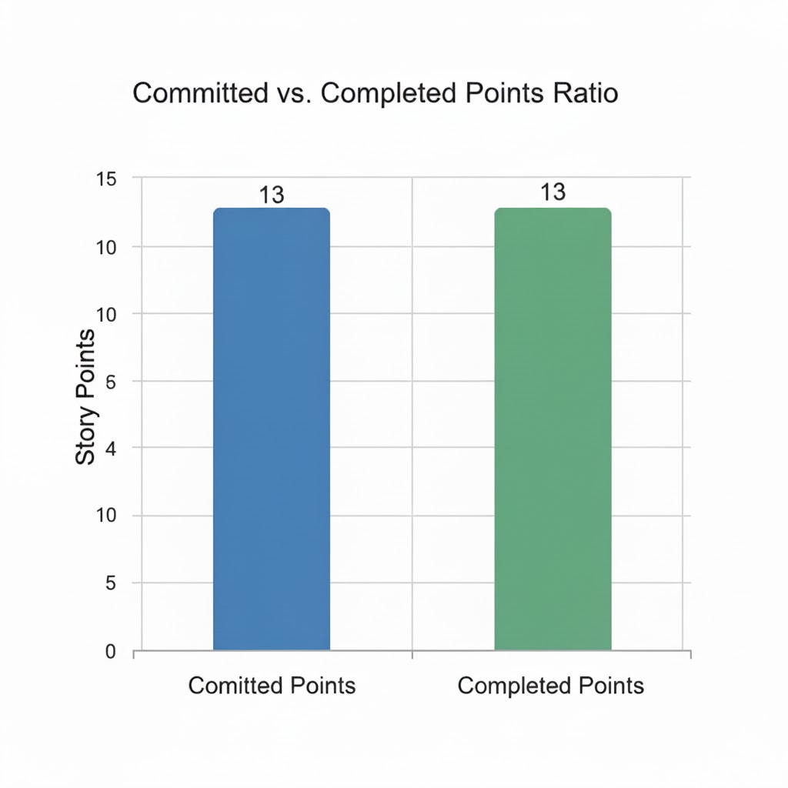
Committed/Compteted Ratio

Slide 37
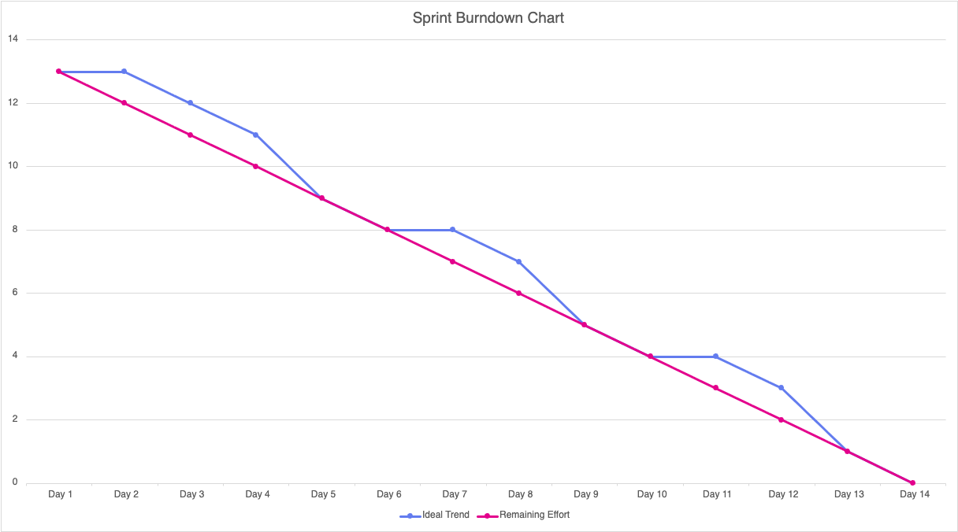
Metrics: Burndown Chart

Slide 38
Sprint 3 retrospective
What Went Well
All planned user stories (US_03, US_07, US_09) were completed successfully.
100% of test cases passed, including edge cases for refunds, deadlines, and contributions.
Contributions, deadlines, and campaign totals tracked accurately.
Smooth team collaboration and coordination for tasks, merging, and testing.
Significant learning in smart contract logic, Solidity features, and testing practices.
What Could Be Improved
Some tasks, especially complex test scenarios, took longer than estimated.
Documentation for smart contract deployment and usage could be more detailed.
Rare edge cases were discovered later than ideal; earlier identification would save time.
Action Items
Plan comprehensive tests early to cover all scenarios.
Improve documentation for deployment, usage, and maintenance.
Refine task estimation using historical sprint data.
Conduct peer reviews to identify uncommon edge cases early.
Prepare smart contracts for future front-end integration.

Slide 39
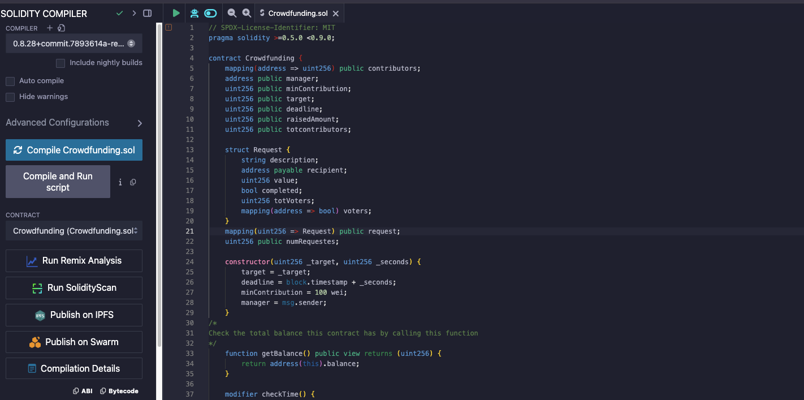
Project demo

Slide 40

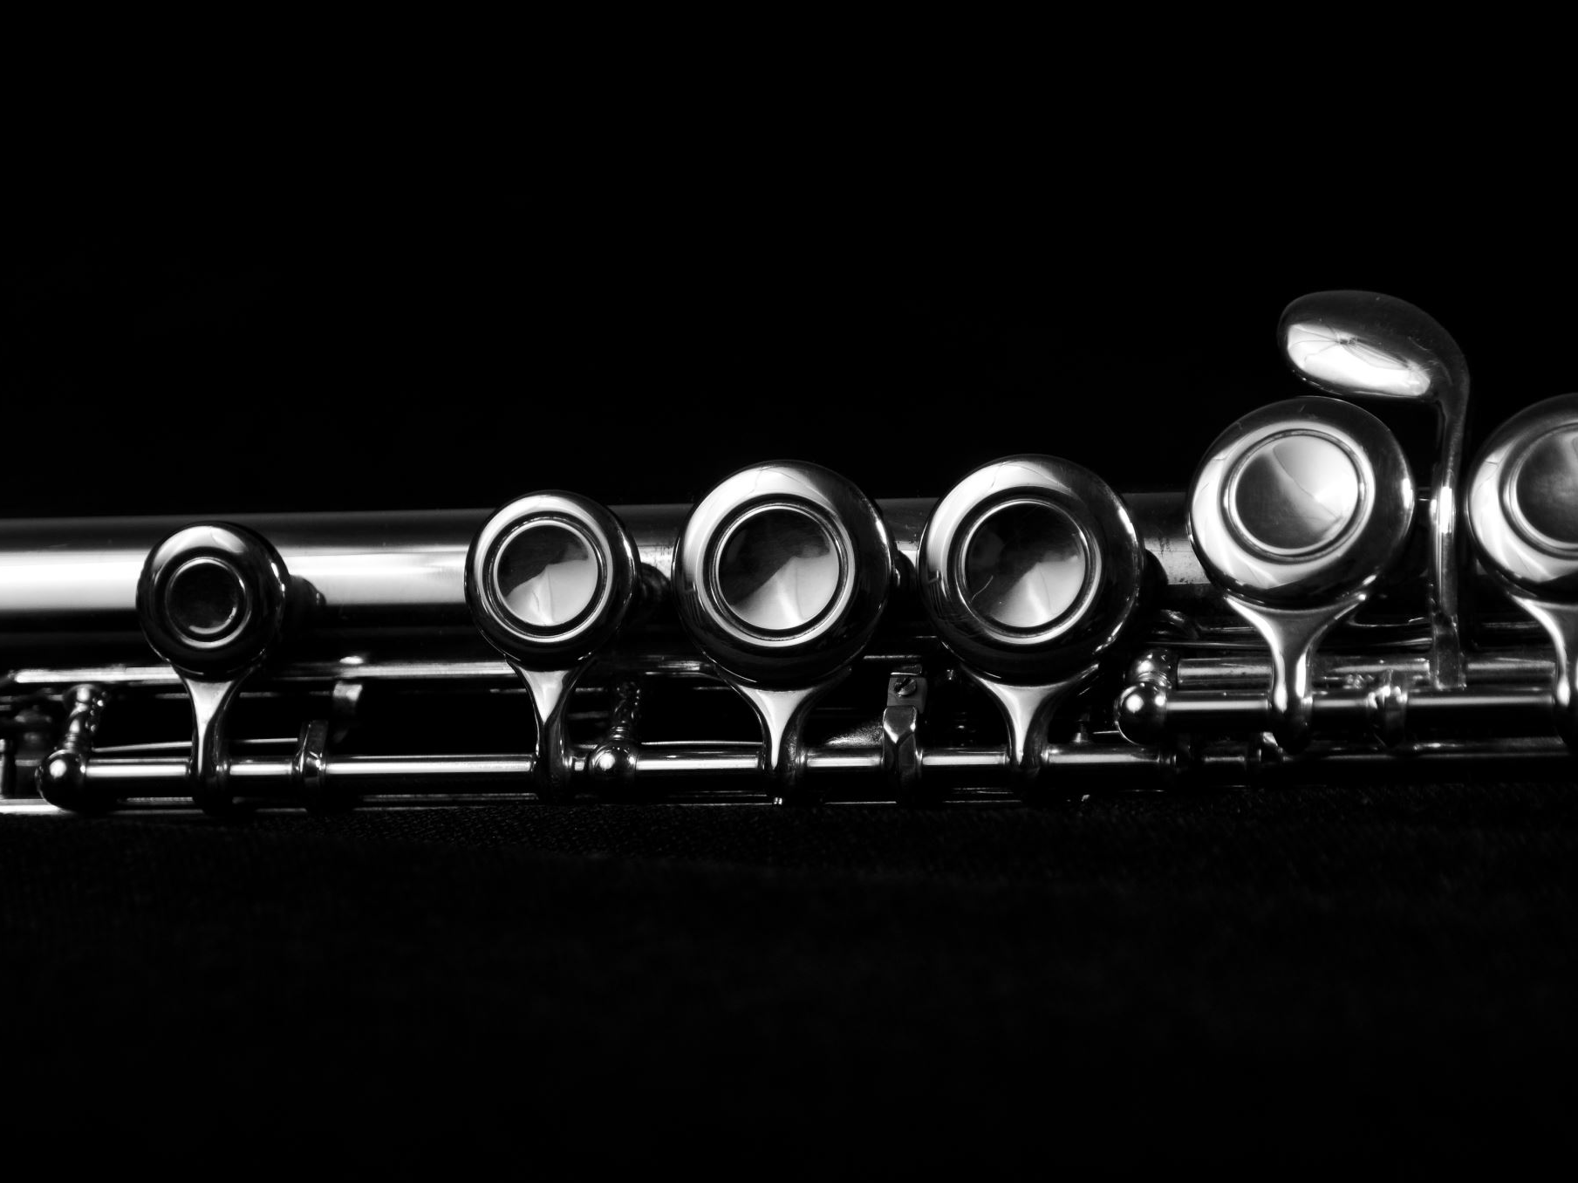
Wiki Page LINK
https://github.com/htmw/F2025-Team2/wiki

Slide 41
Thank You!

